Slide 1
Benchmarking Resources and Tips
An Overview of the Publicly Available Benchmarking Resources in Higher Education

Slide 2
Overview
Resources we will go over today:
Integrated Postsecondary Education Data System (IPEDS)
Center for Educational Performance and Information (CEPI)
College Score Card by U.S. Department of Education
Graduate Enrollment and Degrees Report (CGS/GRE) (a joint project of Council of Graduate Schools and Graduate Record Examination Board GRE)
Student Achievement Measure (SAM)

Slide 3

Integrated Postsecondary Education Data System
IPEDS

Slide 4
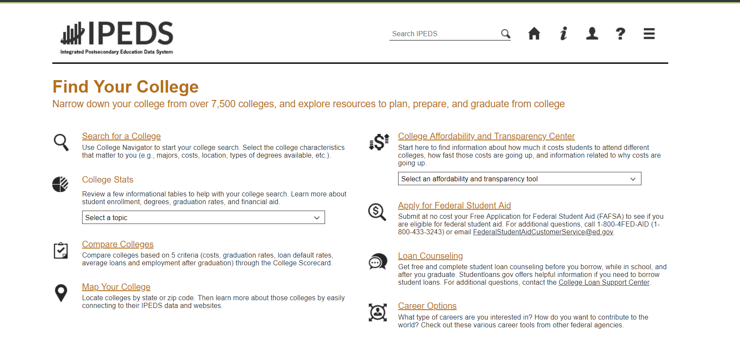
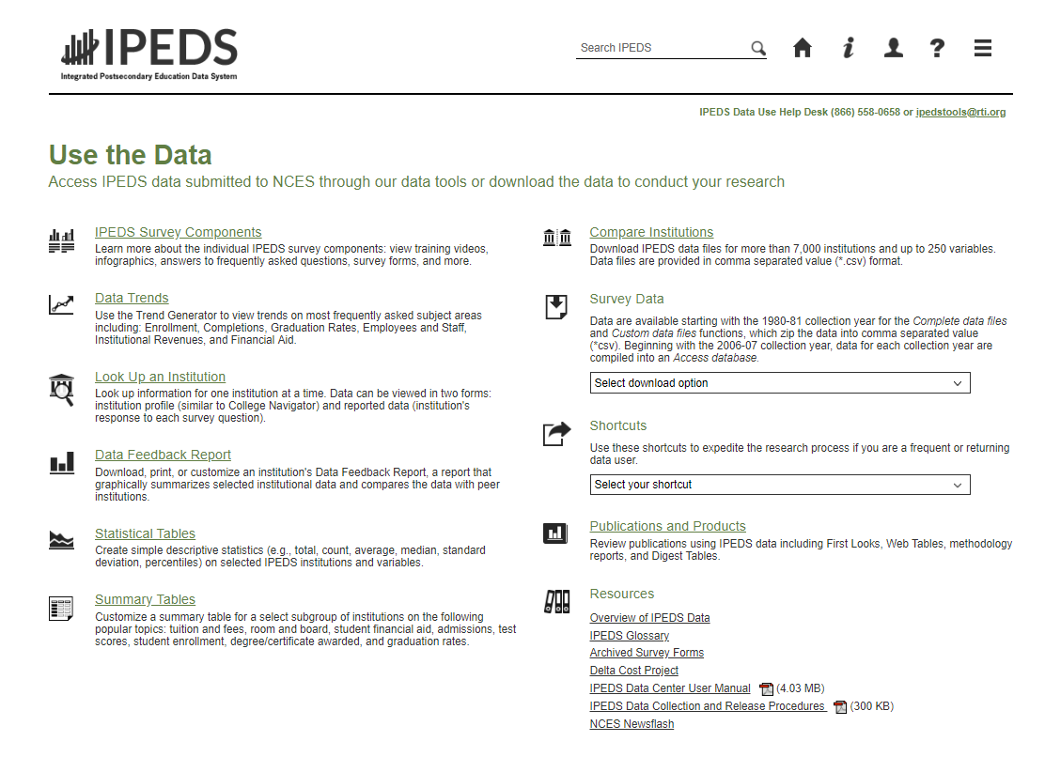
IPEDS Overview
Find Your College
  This is a library of resources, designed primarily for students and parents to find out information about colleges (e.g., programs of study, location, size, financial aid and costs), career options.
Use the Data–
  The focus is more on getting data for research
  Let’s go over the Trend Generator, first…

Slide 5
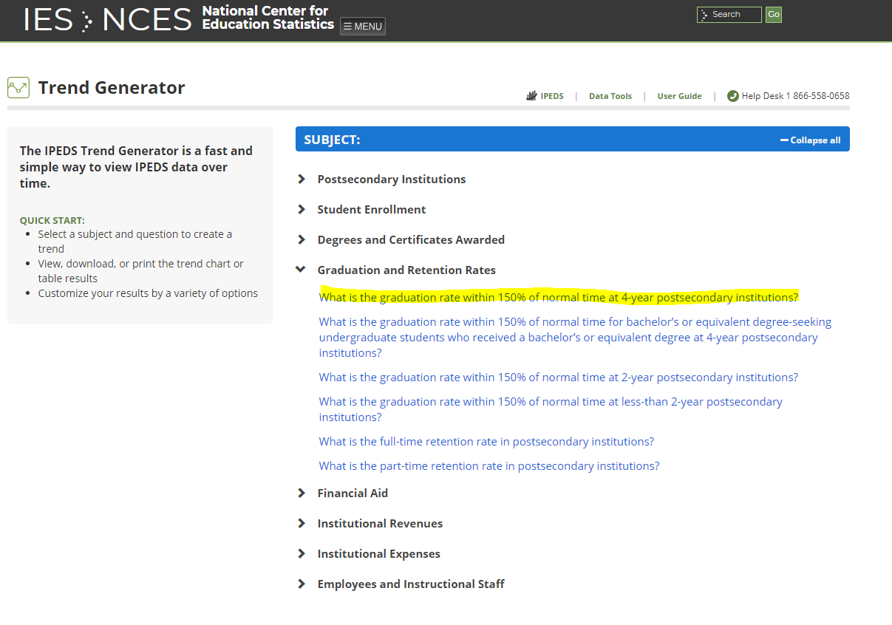
IPEDS –Trend Generator
Data Trends
  Quick answers to commonly
  asked questions
How to use the Trend Generator:
    Select a Subject Area and Pre-defined question.
    View Generated line, bar chart or table
    Customize your results:
      Filter results
      Create a table

Slide 6
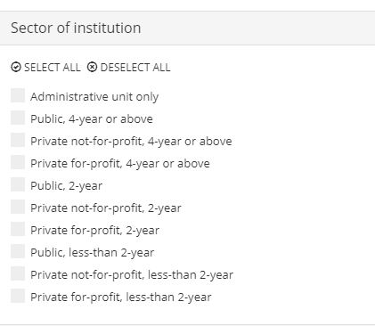
IPEDS – Trend Generator – Customizing Results https://nces.ed.gov/ipeds/trendgenerator/#/
Options to Filter/Limit Results:
Degree Granting Status
Control of Institution
Level of Institution
State
Geographic Area
Sector
  Tip: Sector can be misleading, as some community college are technically 4-year or above, since they offer bachelor’s degrees.
  Sector is a combination of Control and Level
Notes:
Sector Public, 4-Year or above includes all public baccalaureate granting colleges. In Michigan, this includes the 15 Michigan Public Universities and Northwestern Michigan College, Schoolcraft College, Lake Michigan College, Jackson College, and Henry Ford College.

Slide 7
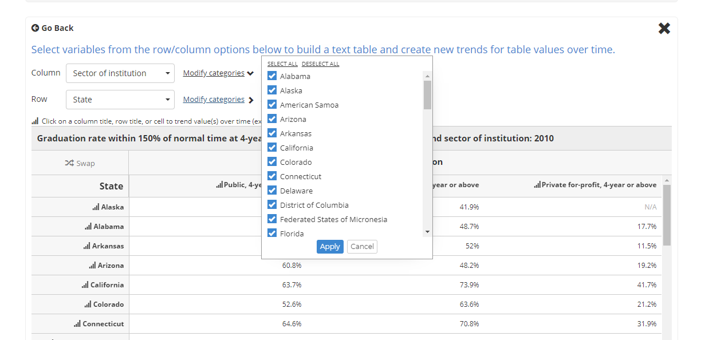
IPEDS – Trend Generator – Customizing Results (Cont.)
https://nces.ed.gov/ipeds/trendgenerator/#/
Customize your results - Build a table
Filter table results in “Modify Categories”
There may be more variables to choose from to add to the table
    Gender
    Geographic region
    Race/ethnicity

Slide 8
IPEDS – Data Feedback Report
https://nces.ed.gov/ipeds/datacenter/Expt/SelectDataReport.aspx
IPEDS Data Feed Back Report
Download a report that compares one institution to peer institutions group median.
Detailed methodological notes and descriptions of statistics are included in the Data Feedback reports
Charts and tables by topic areas:
  Admissions, Enrollment, Awards (Degrees and Certificates), Charges, etc.
  It is your choice to view the institution's report, or create your own
    Institution’s reports are based on either their own Peer group, or one assigned by NCES.
    Custom Data Feedback report – choose which items are on the report
    Statistical Analysis Report – select variables to download comparison statistics or data tables
  Creating your own requires you to select the comparison group

Slide 9
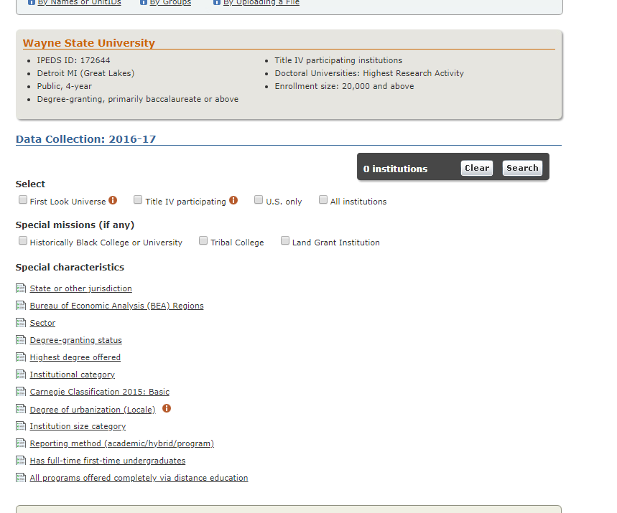
IPEDS Data Center – Selecting Institutions
Many of the tools allow you to have complete control over which institutions are in your comparison group:
  Custom Data Feedback Report
  Statistical Tables
  Summary Tables
  Compare Institutions
Create groups by:
  Names/Unit ID,
  By Group
    EZ Group
    Automatic Group (NCES assigned)
    Saved Group
  Upload file (useful if you have a large list of institutions)
    Selecting Institutions by EZ Group:

Slide 10
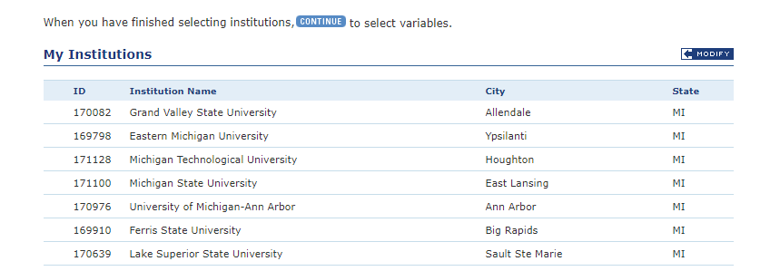
IPEDS Data Center – Selecting Institutions
EZ Group is a convenient way to select institutions based on characteristics
View the list once you’re done, and you have the option to further modify the list
Key Characteristics for Wayne State University:
Once the group is selected, you will view the list.
Click modify to keep or remove selected institutions. Add more by name or UnitID, upload, or group.
  Once you add more by group, you will be prompted to either combine the groups or keep one of the lists generated.
Characteristics to select Michigan Public Universities:
  State: MI
  Sector: Public, 4-Year
  Institutional Category: Degree-granting, primarily baccalaureate or above
Notes:
To select Michigan Public Universities, select

Slide 11
IPEDS – Compare Institutions
Use this option if you are looking to find answers to other questions, or need institution-level data to compute your own statistics.
In this tool, you can:
  Choose multiple years,
  Select institutions based on characteristics or select your own list of institutions by name,
  Download data for any variable reported, and/or frequently used or derived variables
Notes:
This tool often leaves you with some work to do. The variable names can be confusing, downloads may need restructuring TIP: The naming convention is generally Variable Name, Survey, year.

Slide 12
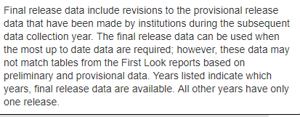
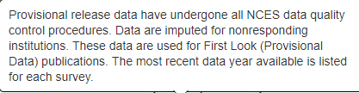
IPEDS Data Center – Things to Consider
One thing to ask yourself when using IPEDS data:
Should I use Final Release Data ?
Or Provisional Release Data?
Also, ask yourself which option for accessing the data will work best for you? Consider how many years you will need and the amount of detail you will need.
There are more options that we haven’t covered in this presentation to consider.

Slide 13
Center for Educational Performance and Information
CEPI

Slide 14
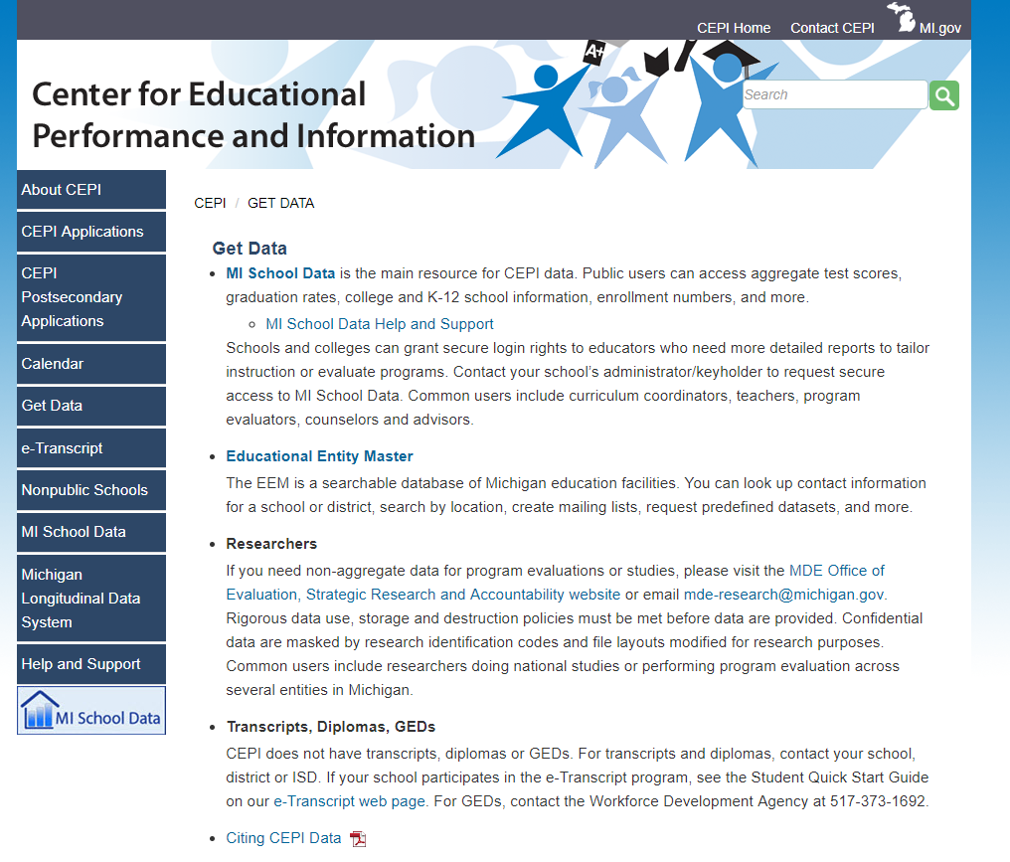
Center for Educational Performance and Information
https://www.michigan.gov/cepi/0,4546,7-113-21423---,00.html
About: According to its website, the Center for Educational Performance and Information (CEPI) is a State agency “that was established…to coordinate the collection, management and reporting of education data, from early childhood through K-12 and postsecondary education, and into the workforce.”
Aggregate Data Sources:
  MI School Data for College and K-12 School
  information
    Organized layout, easy to use
    Dashboards for many measures
    Easily share by download/print, getting link to report
    https://www.mischooldata.org/
  Educational Entity Master (EEM)
    Directory information
    https://cepi.state.mi.us/eem/
  MDE’s Publications and Reports
    https://www.michigan.gov/mde/0,4615,7-140-6605_6539---,00.html

Slide 15
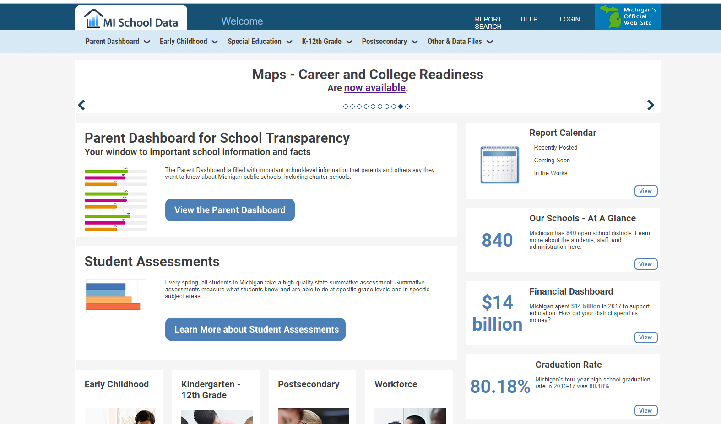
CEPI – MI School Data
MI School Data holds an abundance of information about education in Michigan:
Parent Dashboard
Early Childhood Data
Special Education Counts by ISD/District
K- 12
Postsecondary
District Summaries
Staffing
Student Counts by various attributes:
Assessment (test scores)
Finances
Graduation rates
Workforce
Maps
  Graduation Rates, College Readiness, Career Readiness, 6- Month College UG Enrollment, College Remedial Coursework after Enrollment
MI School Data - Quick Start Guide
  https://www.michigan.gov/documents/cepi/QuickStartGuide_446701_7.pdf

Slide 16
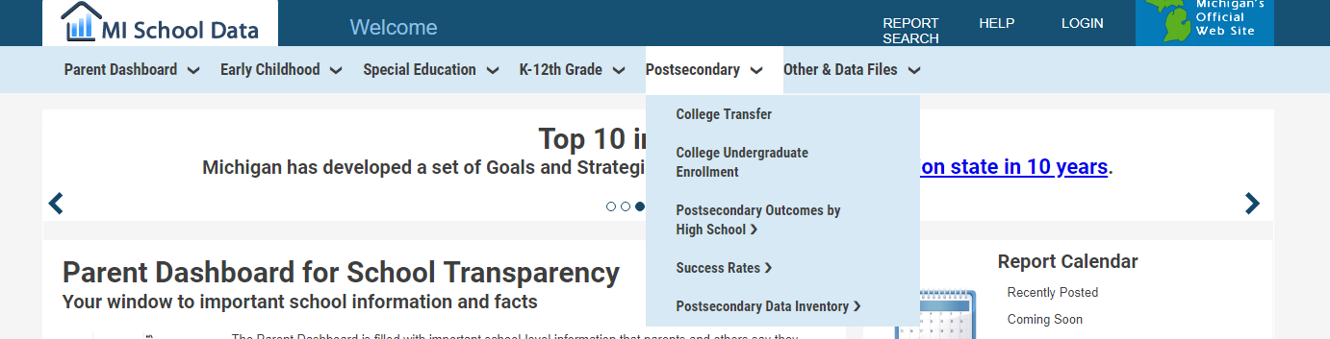
CEPI – MI School Data
Example Use of Postsecondary Data
  Select Postsecondary from the main menu and go to area of interest

Slide 17
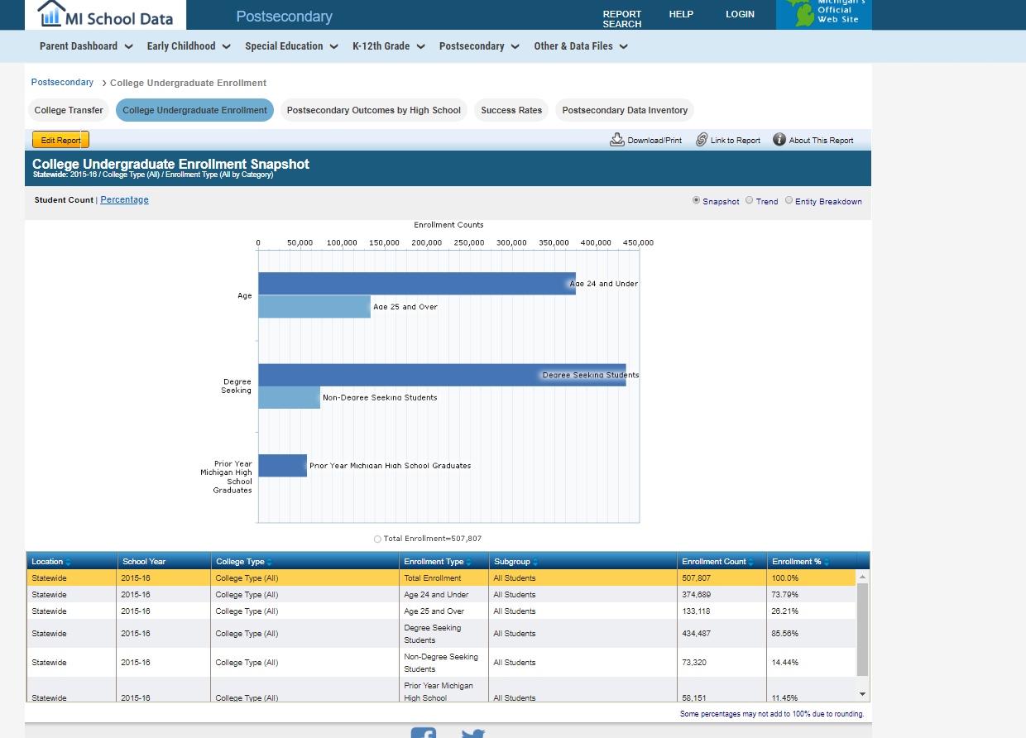
CEPI – MI School Data
Example Use of Postsecondary Data:
Easily change the Report being viewed
Easily change parameters (Edit Report)
View snapshot, trend, or entity breakdown
Get link or download
①
④
②
③
①
②
③
④

Slide 18
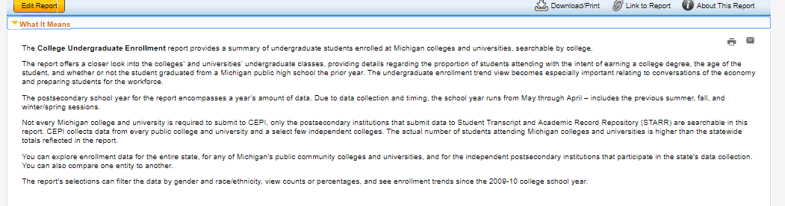
CEPI – MI School Data
About this report
What it means (description)

Slide 19
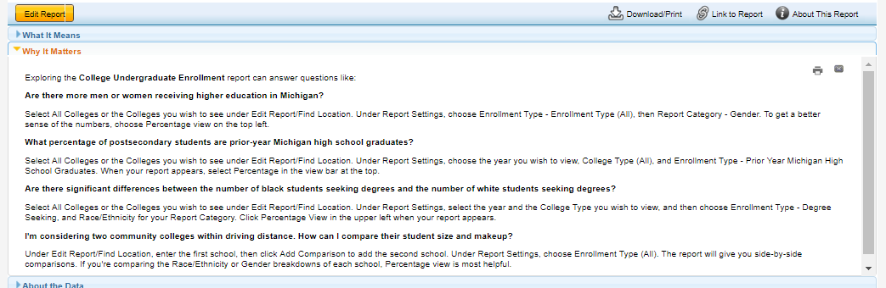
CEPI – MI School Data
About this report
What it means (description)
  Why it Matters (context)

Slide 20
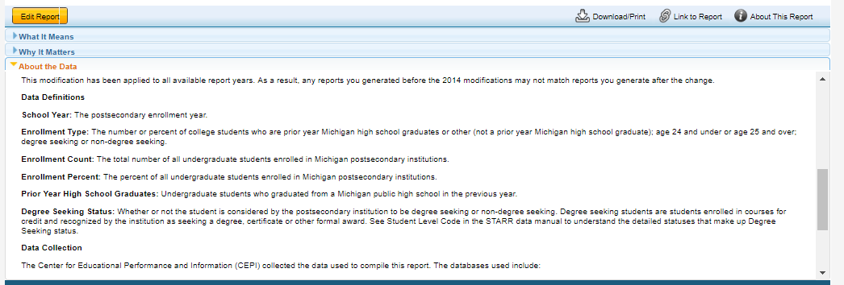
CEPI – MI School Data
About this report
What it means (description)
  Why it Matters (context)
  About the Data (Definitions and Sources)

Slide 21
CEPI – MI School Data
Other Resources that are available in CEPI’s MI School Data:
  Links to data sets
  Maps – College and Career Readiness by ISD
  Annual Education Report
  Data Files:
    K-12 – Assessment, Enrollment, College Readiness, Attendance, College Remedial Coursework, College Progression, EEM Data, Graduation, Mobility, Resident/Non-Resident
    College - Enrollment and transfer enrollment by year, college, race/ethnicity, gender, average GPA, Undergraduate Enrollment by college, MI High School grads, age
    Additional K -12 – District information, staffing, financial reports, FTE, special student group counts (non-public, free and reduced lunch, homeless, special education, etc.)
  Workforce Data
    Wages by educational attainment and field of study

Slide 22
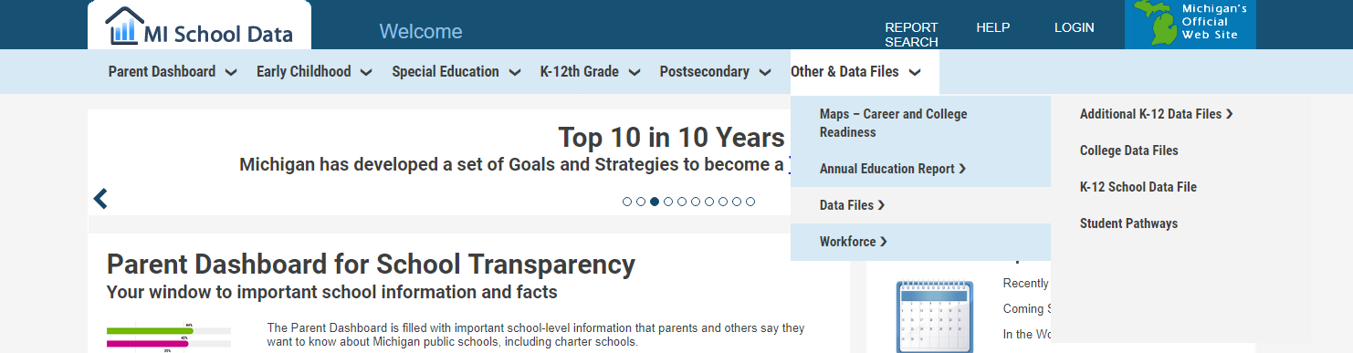
CEPI – MI School Data
To download a data set:
  Go to Other & Data Files in upper right hand corner of MI School Home Page,
  Select Data Files
  Student Pathways is not public
  https://www.michigan.gov/documents/cepi/DataFile_How-ToGuide_20141201_475339_7.pdf
①
②
①
②

Slide 23
College Scorecard
by U.S. Department of Education

Slide 24
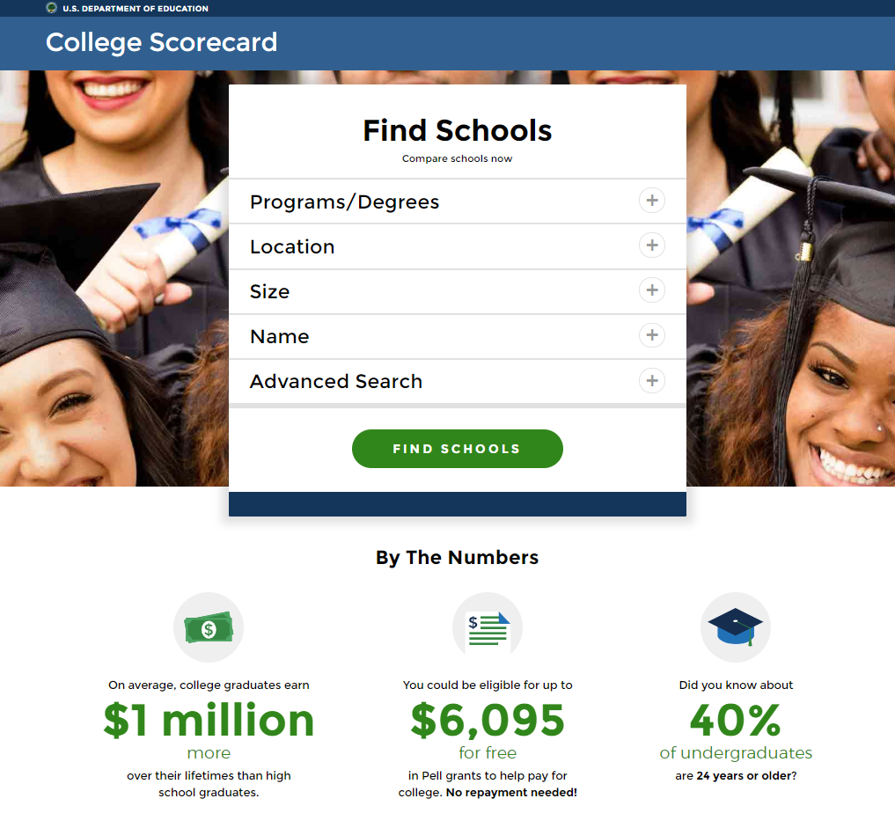
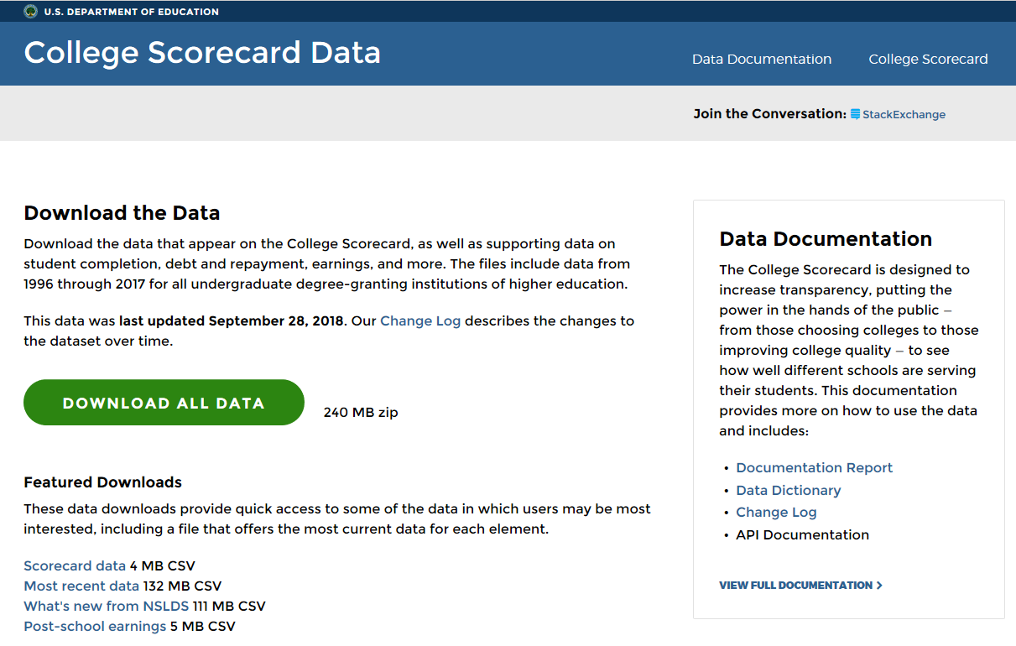
College Scorecard and College Scorecard Data
https://collegescorecard.ed.gov/
About: College Scorecard is an interactive tool that is released by U.S. Department of Education to provide snapshot about an institution’s affordability and value.
https://collegescorecard.ed.gov/data/
All the data that appear on the College Scorecard, as well as supporting data on student completion, debt and repayment, earnings, and more can be downloaded. The files include data from 1996 through 2017 for all undergraduate degree-granting institutions of higher education.

Slide 25
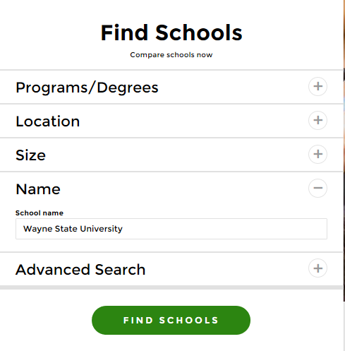
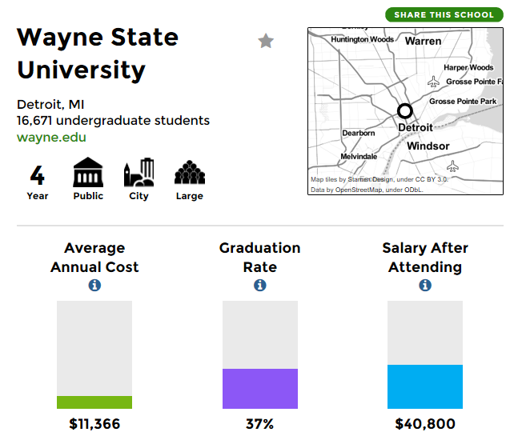
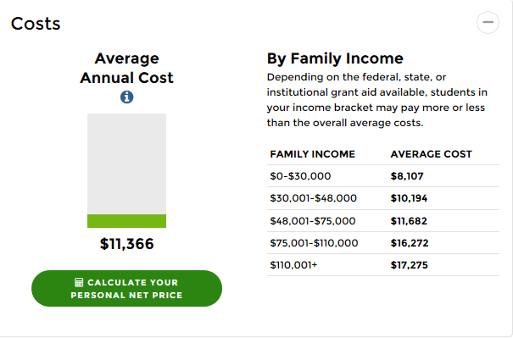
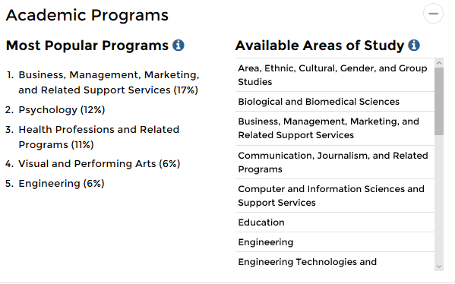
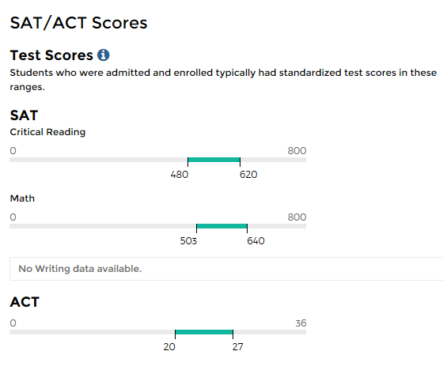
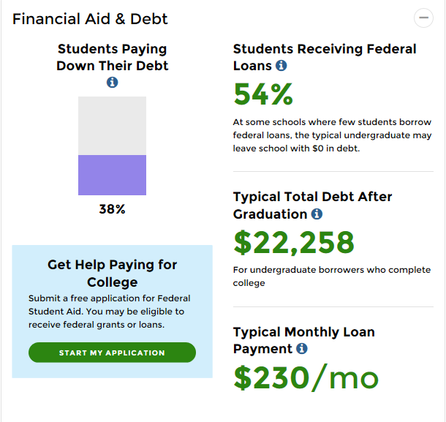
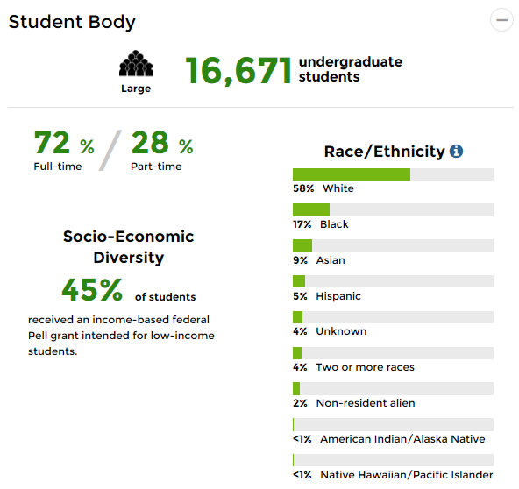
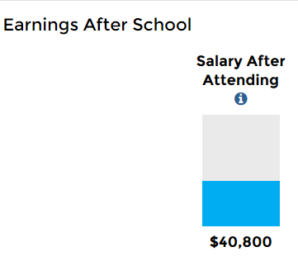
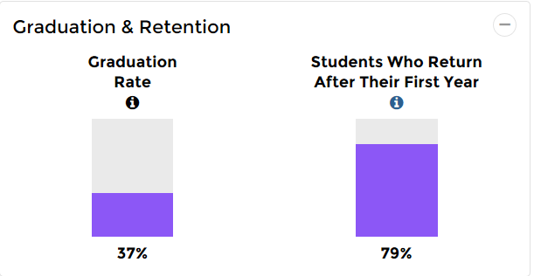
College Scorecard Example 1
Get One University’s College Scorecard
Type School Name of your interest to get one university’s scorecard to view scorecard items:
①Costs
②Financial Aid &Debt
③Student Body
④Graduation & Retention
⑤Earnings After School
⑥Academic Programs
⑦SAT/ACT Scores
①
⑥
⑦
②
③
⑤
④

Slide 26
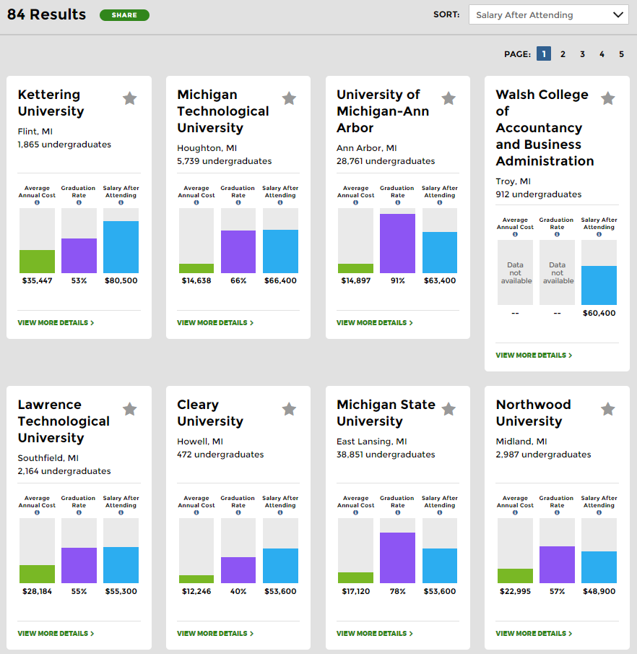
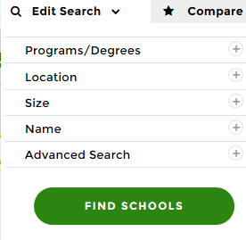
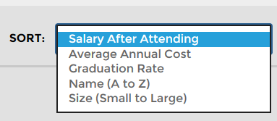
College Scorecard Example 2
Compare Universities
①Search university of interest by size, location, programs/degrees, etc., by clicking the “+” sign.
②All of the results will pop up as a small scorecard.
③You can sort search results based on Salary After Attending, Average Annual Cost, Graduation Rate, Name (A to Z), and Size
②
①
③

Slide 27
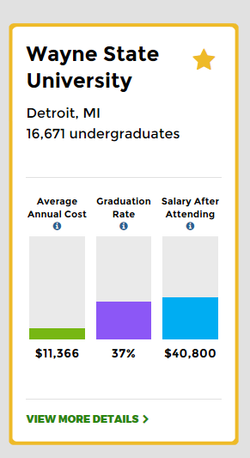
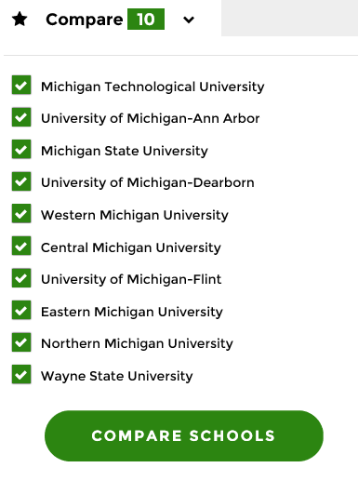
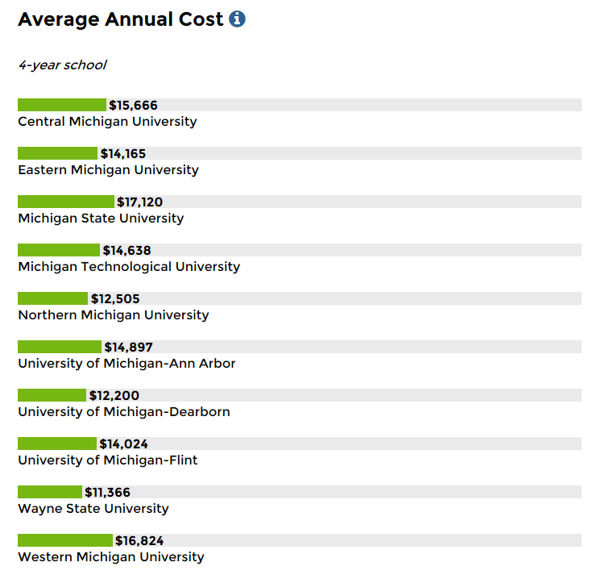
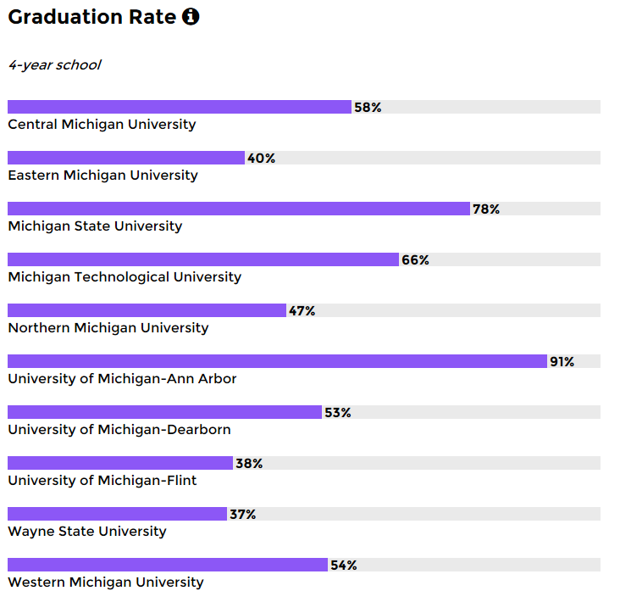
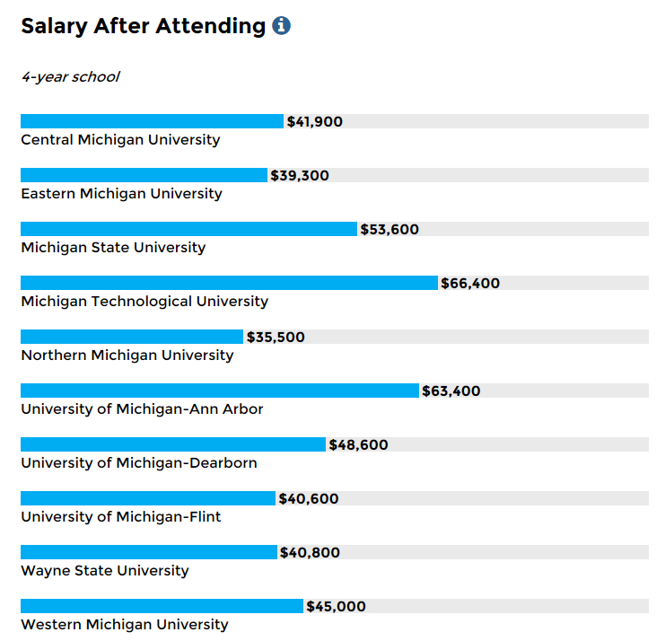
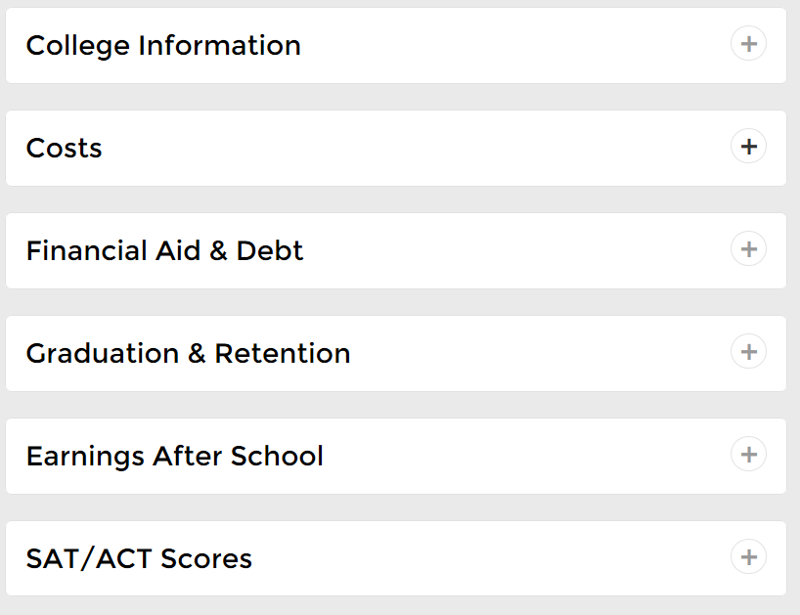

College Scorecard Example 2
Compare Universities (Cont.)
④
④To build a comparison list, you can click the “star” sign. Up to ten universities can be added to a comparison list.
⑤You can view your comparison list on under Compare menu.
⑥After clicking on COMPARE SCHOOLS, a web report will be generated comparing Average Annual Cost, Graduation Rate, Salary After Attending, Financial Aid & Debt and more.
⑦You can email the report or share it on Twitter, Facebook, or LinkedIn.
⑤
⑥
⑦

Slide 28
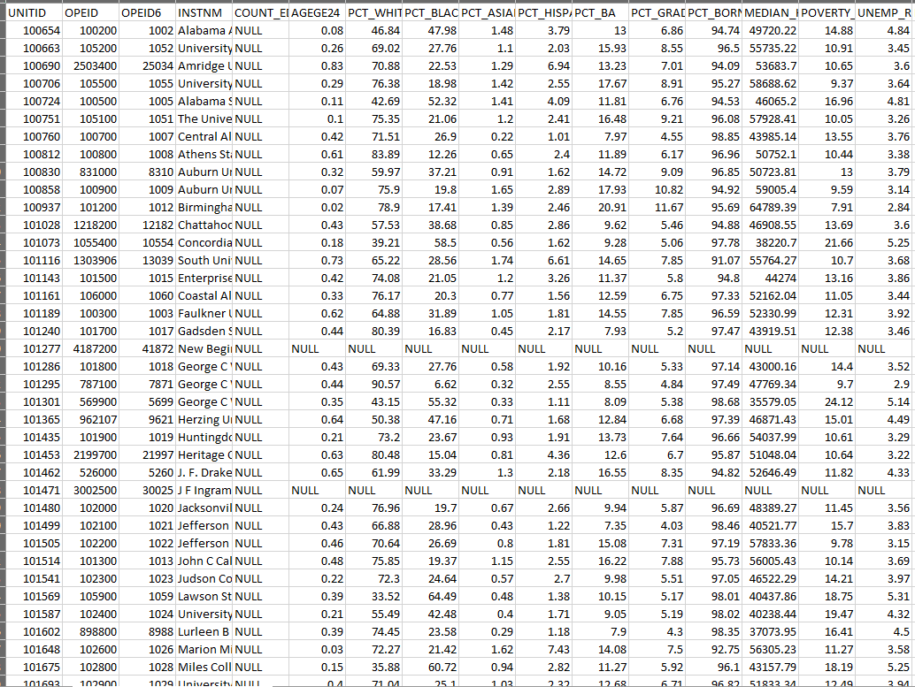
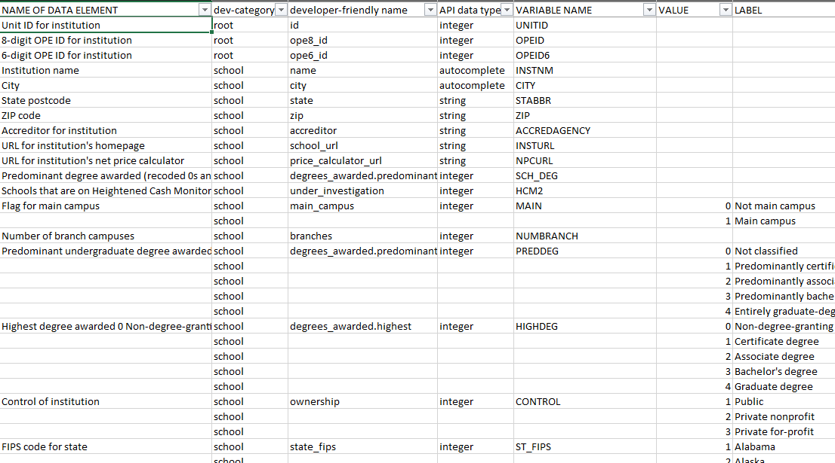
College Scorecard– Datasets Available
①
There are about 240MB of data that can be downloaded from College Scorecard Data, including
  Scorecard data
  Most recent data
  What’s new from NSLDS
  Post-school earning①
Data Documentation is designed to increase transparency and provides more information on how to use the data.
  Documentation Report
  Data Dictionary②
  Change Log
②

Slide 29
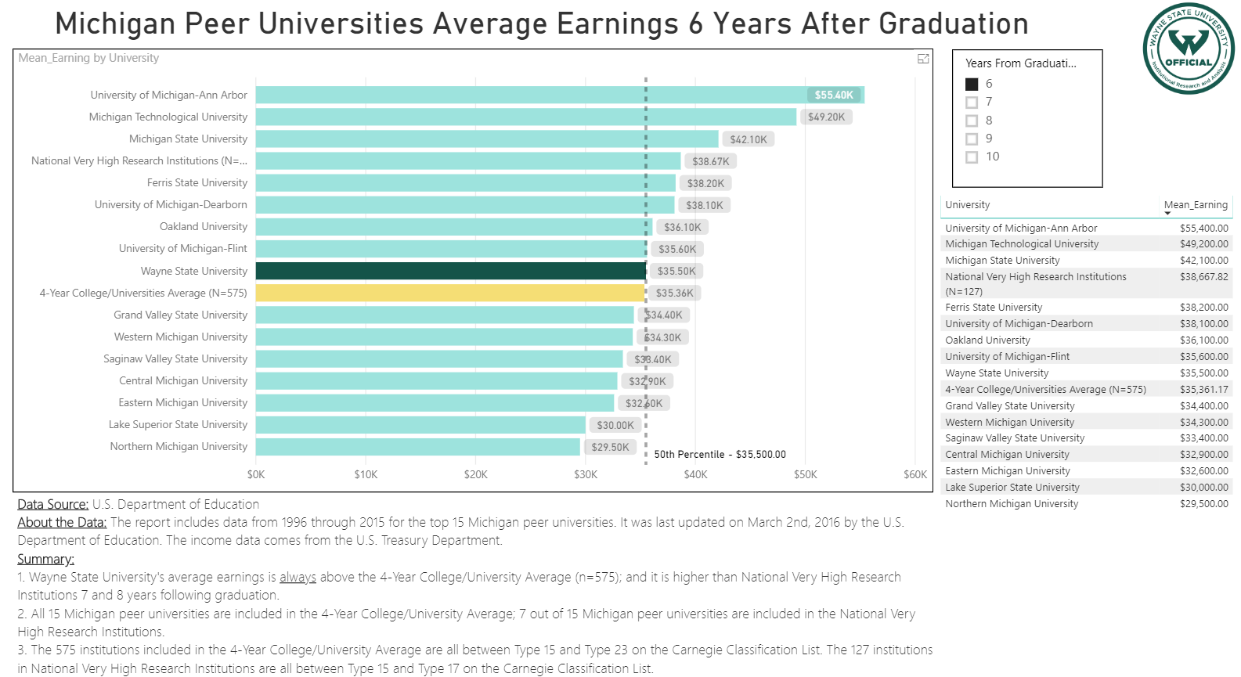
College Scorecard
Post-school Earning Data Use Example
Source: Post-school Earning Data
Variables used are
  Location (STABBR, CITY)
  University Category (CCBASIC, CCUGPROF, CCSIZET)
  Post-school Salary Average and Standard Deviation after 6, 7,8,9,10 years of attending school (mean_earn_wne_p6, mean_earn_wne_p7, mean_earn_wne_p8, mean_earn_wne_p9, mean_earn_wne_p10,sd, earn_wne_p6, earn_wne_p7, earn_wne_p8, earn_wne_p9, earn_wne_p10)
Application: A Post-school earning comparison dashboard created based on this data, to compare Wayne State University with 14 other MI peer universities and National Average.
https://app.powerbi.com/view?r=eyJrIjoiNDAyYjA5OGMtYTdmNy00MjViLTk0NGQtNjYyZjBkNmExYWMwIiwidCI6ImU1MWNkZWM5LTgxMWQtNDcxZC1iYmU2LWRkM2Q4ZDU0YzI4YiIsImMiOjN9

Slide 30
Graduate Enrollment and Degrees Report
CGS/GRE

Slide 31
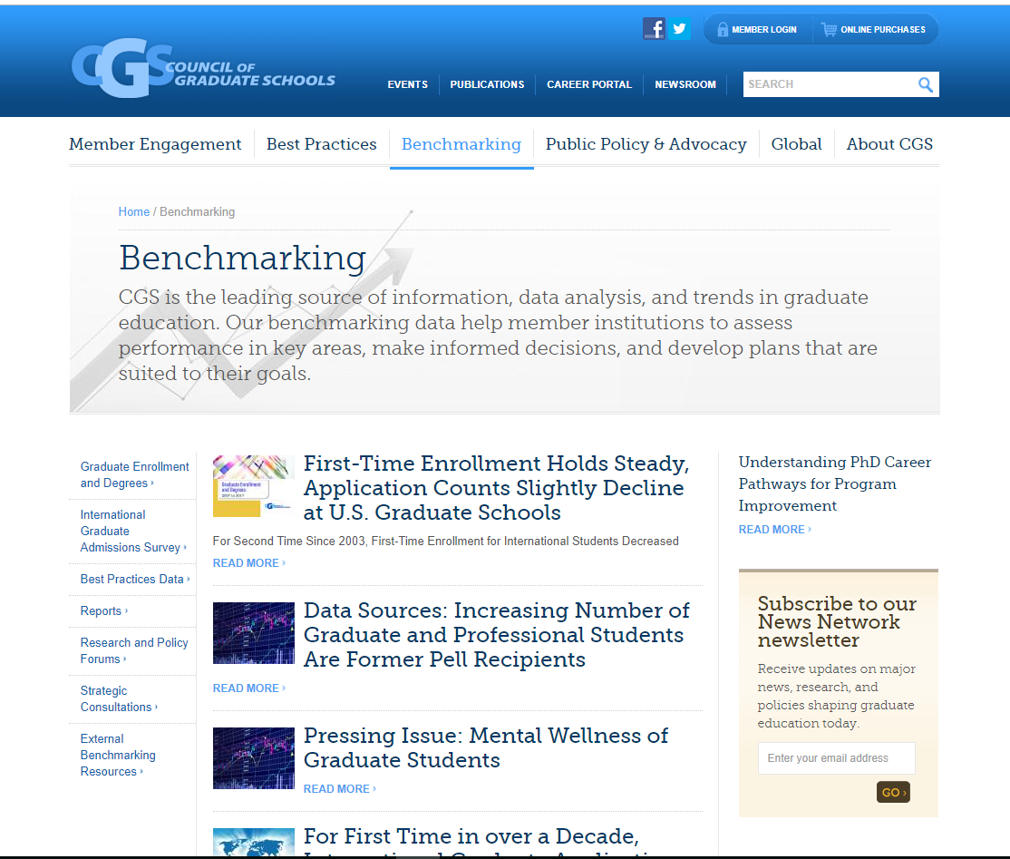
Graduate Enrollment and Degrees - CGS/GRE
CGS has many benchmarking resources available, including:
  Graduate Enrollment and Degrees
  International Graduate Admissions
  Reports
  https://cgsnet.org/benchmarking

Slide 32
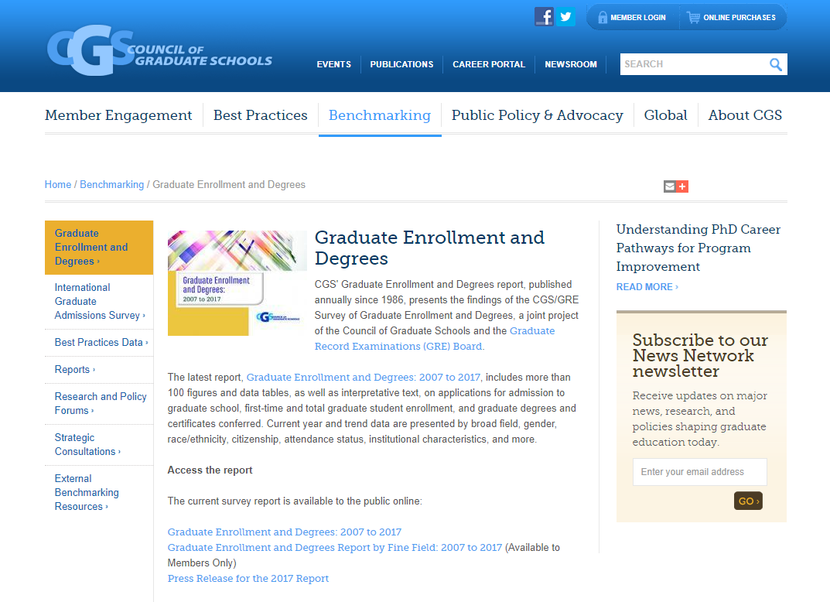
Graduate Enrollment and Degrees - CGS/GRE
Graduate Enrollment and Degrees
https://cgsnet.org/graduate-enrollment-and-degrees

Slide 33
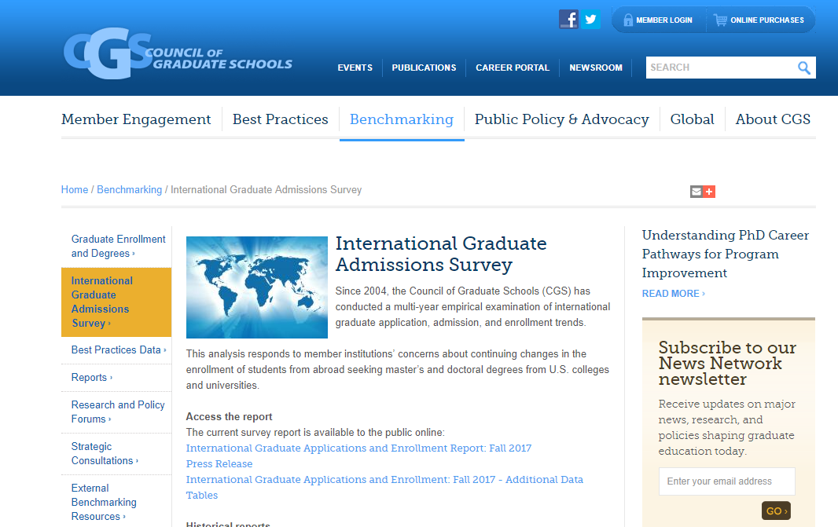
Graduate Enrollment and Degrees -CGS/GRE
International Graduate Admissions Survey
https://cgsnet.org/international-graduate-admissions-survey

Slide 34
Student Achievement Measure
SAM

Slide 35
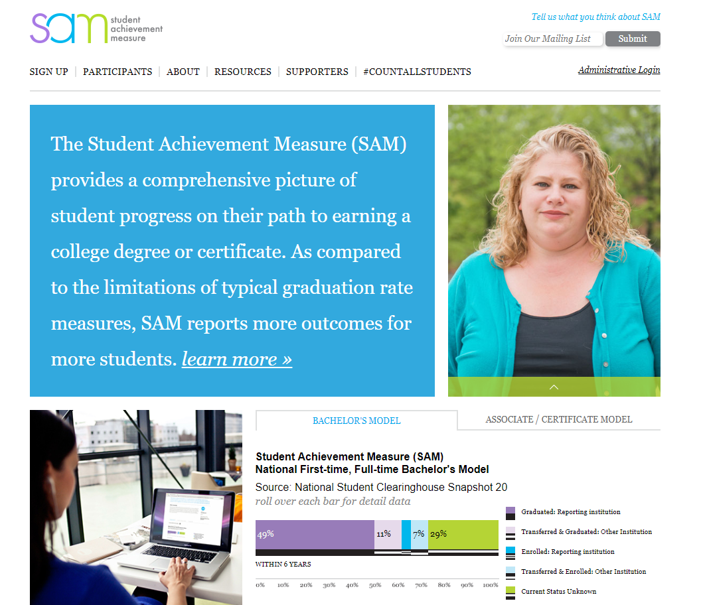
Student Achievement Model (SAM)
Student Achievement Model provides information pertaining to graduation and retention in undergraduate programs
  http://www.studentachievementmeasure.org/
Accounts for institutional mobility
Models for Bachelor and Associate’s degree programs

Slide 36
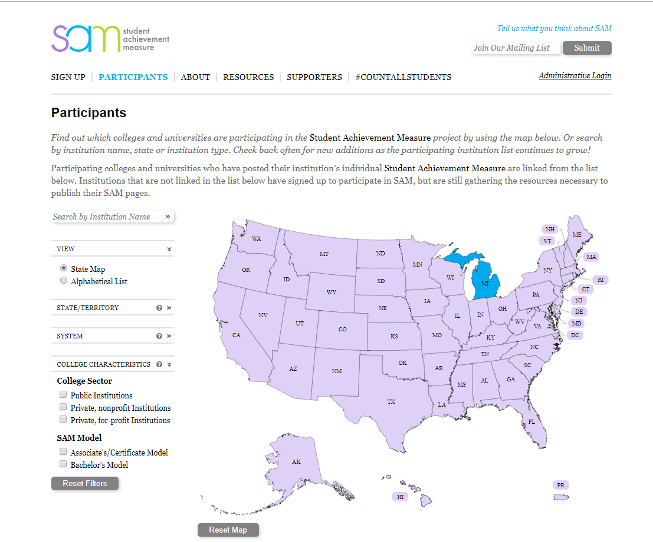
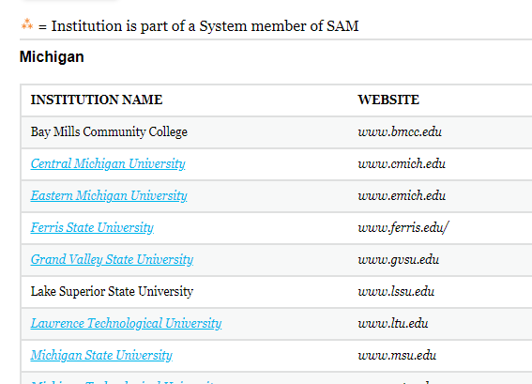
Student Achievement Model (SAM)
Easily filter results http://www.studentachievementmeasure.org/participants

Slide 37
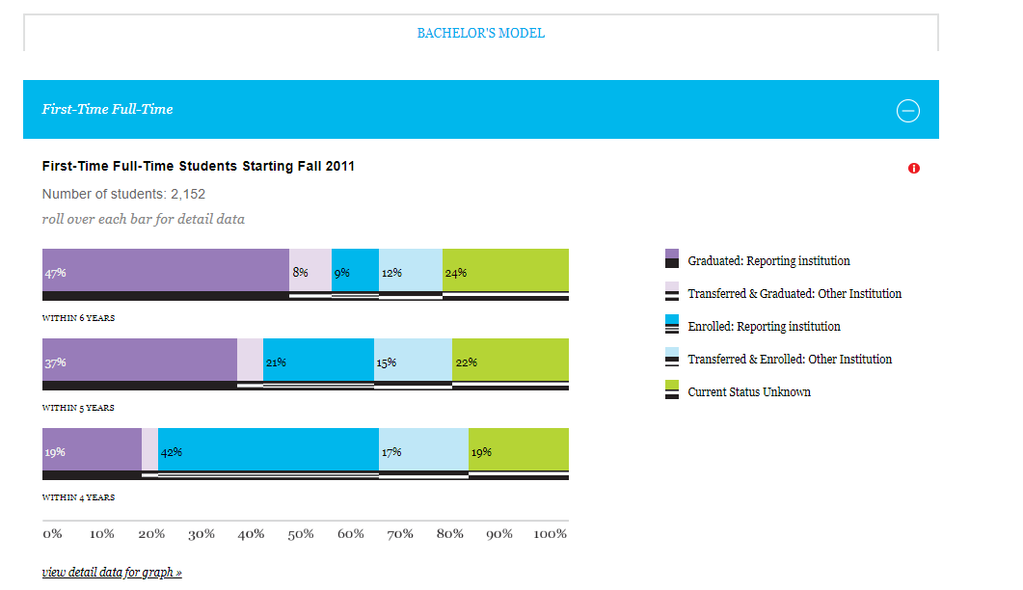
Student Achievement Model (SAM)
View one institution at a time
Choose First Time (Freshmen)
-OR –
Transfer

Slide 38
Thank you for watching.
Office of Institutional Research and Analysis
https://oira.wayne.edu/

